Slide 1

ODBC2KML Project Demo
PolyTech Industries, Inc.
April 13, 2010

Slide 2
Agenda
Course Overview
Project Overview
Major Functionality
Technical Design
Interface Design
Project Demo
Questions

Slide 3
Project working structure
Two weekly meetings
Weekly reports
Time
Tasks

Slide 4
Impacts of this course
Real world development experience
Builds teamwork and communication skills
Helps students understand the Software Engineering process

Slide 5
The Team

Slide 6
The Hours

Slide 7
Why ODBC2KML?
Current situation: manually generating KML from databases
Solution: create a system that automates the KML generation

Slide 8
Project Overview
Connect to a database
Map database field(s) to KML field(s)
Latitude/Longitude
Placemark Name
Insert Field Values into Description
Generate KML

Slide 9
Major Functionality
Create Connection
Edit Connection
Delete Connection
Generate KML File
Web Service
Web Application
Preview KML in browser by Google Earth Plugin

Slide 10
Technologies Used
ASP.NET 2.0
C#.NET
JavaScript/Ajax
Microsoft SQL Server Database

Slide 11
Technical Design
Core ODBC2KML classes
ODBC Database Connections
Public facing Web Pages
KML Generation Web Service

Slide 12
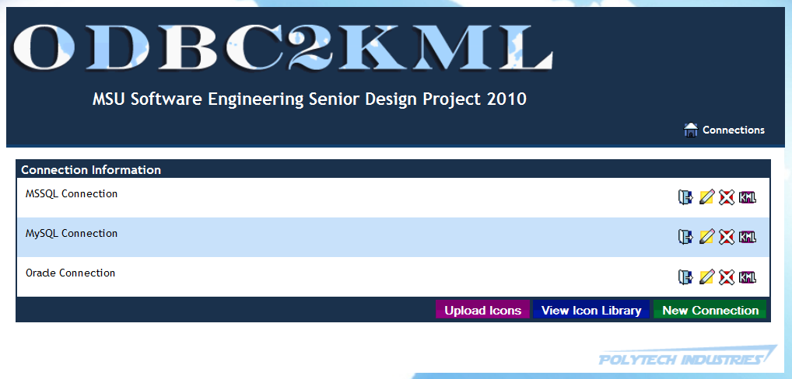
Design – Main Page

Slide 13
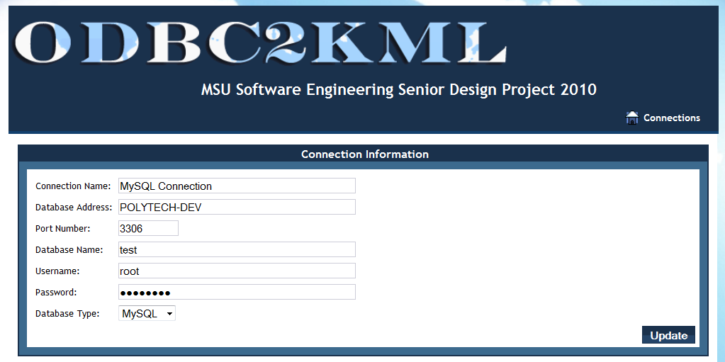
Design – ConnDetails: ConnInfo

Slide 14
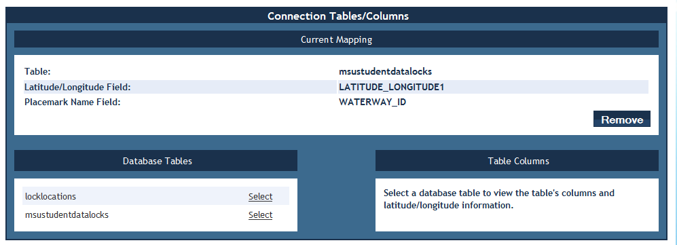
Design – ConnDetails: Mapping

Slide 15
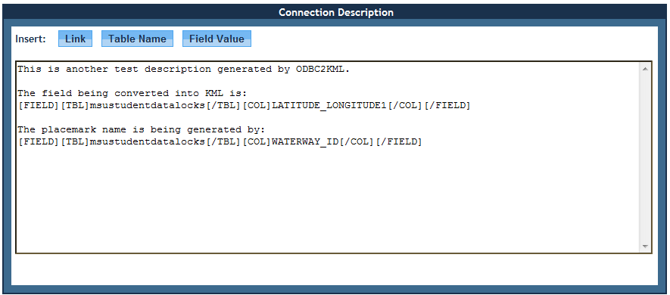
Design - ConnDetails: Description

Slide 16
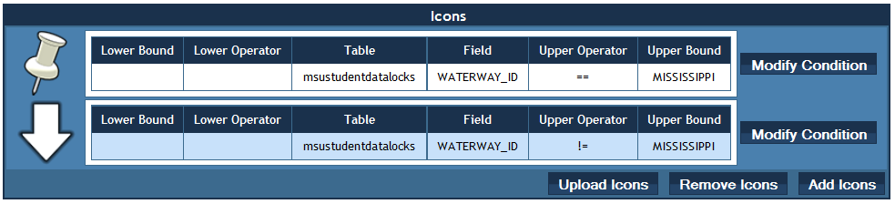
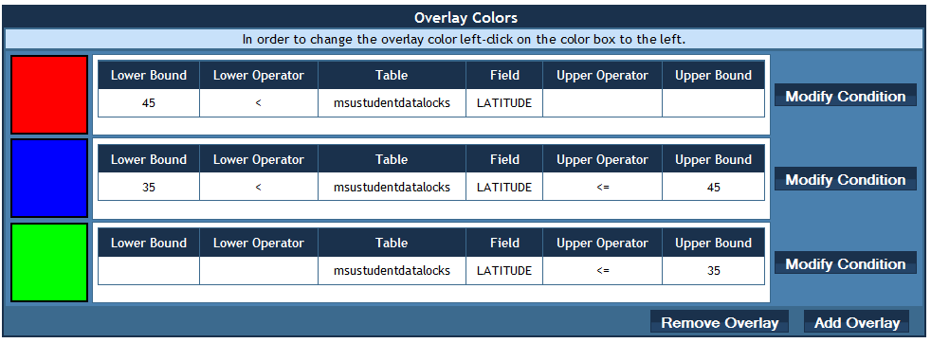
Design – ConnDetails: Icons and Overlays

Slide 17
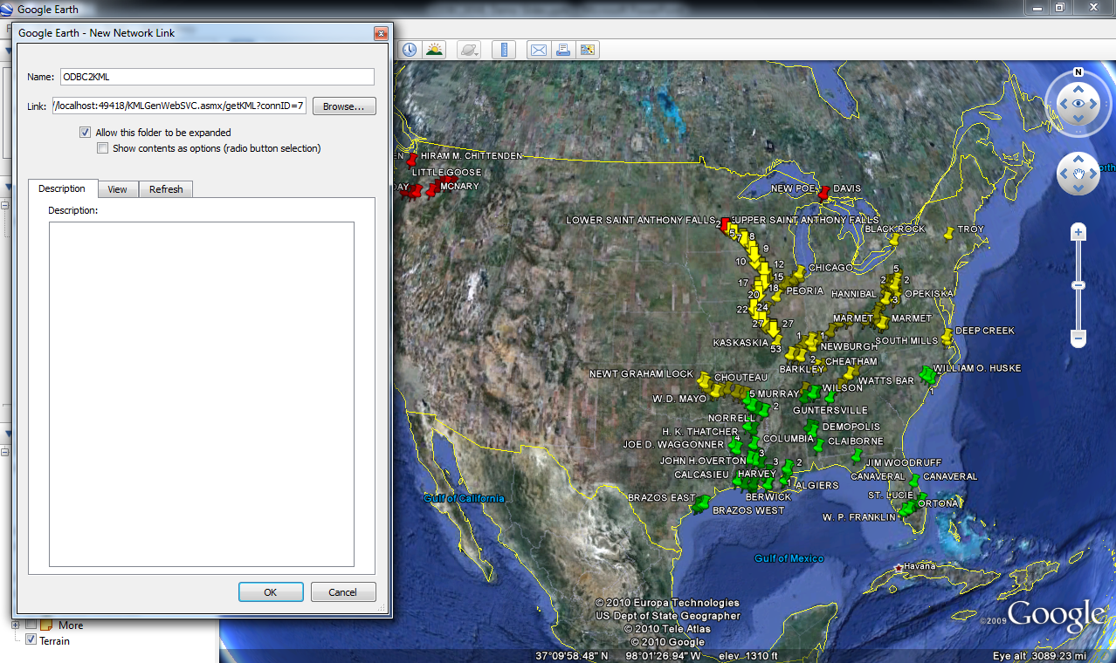
Design - KMLGenWebSVC

Slide 18
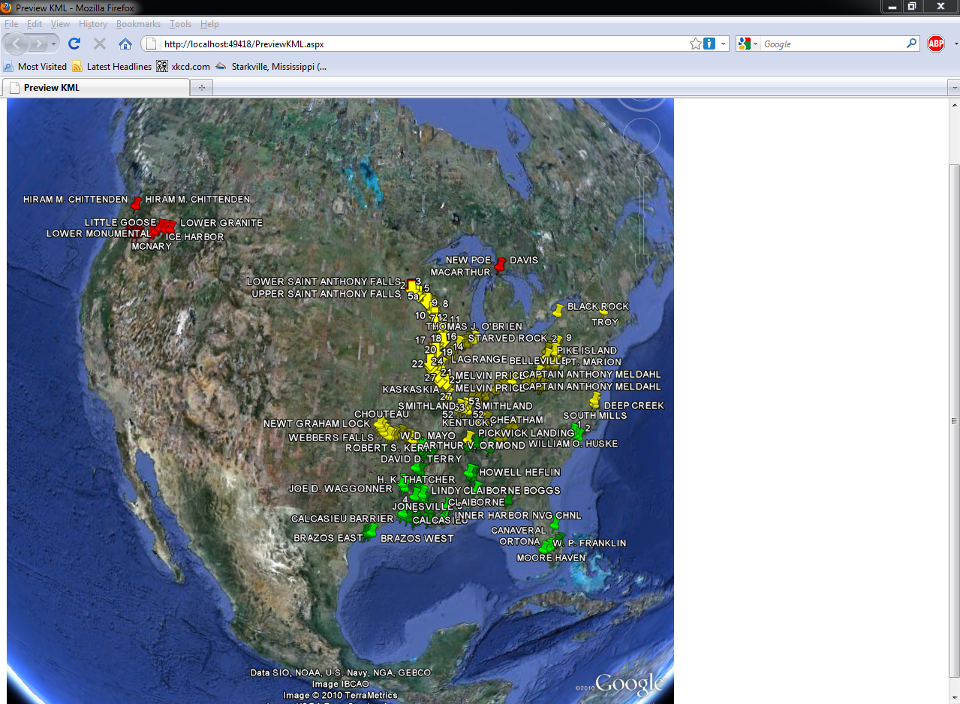
Design – Preview KML

Slide 19
Requirements and Design Questions?

Slide 20
Demo Hardware Setup
ODBC2KML in VM
Client Laptop
Remote Data Source in VM

Slide 21
Demo

Slide 22
Questions?

